Slide 1


The Power
of Duplication
Ben Mayo -
Vice President of Associate Experience/Success
Notes:
Introduction to the speech.
NEXT SLIDE – PRESS BUTTON

Slide 2
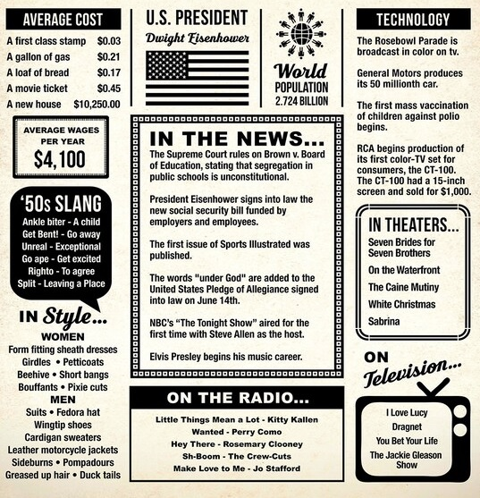
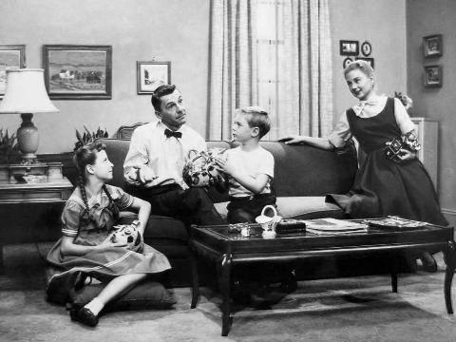
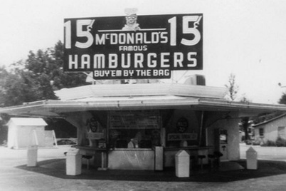
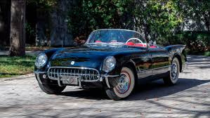
1954
Notes:
Historical context of 1954,
Technological advancements, civil rights movement, US economic growth .
"I Love Lucy" and Chevrolet Bel Air, Ford Thunderbird – American Ingenuity and Progress.
Imagine a gentleman - Early 50s - journey from Chicago to LA – then towards Mojave – SMALL TOWN
Parks Car – Gets in Long Line at Windows
What he experiences that day
NEXT SLIDE – PRESS BUTTON

Slide 3
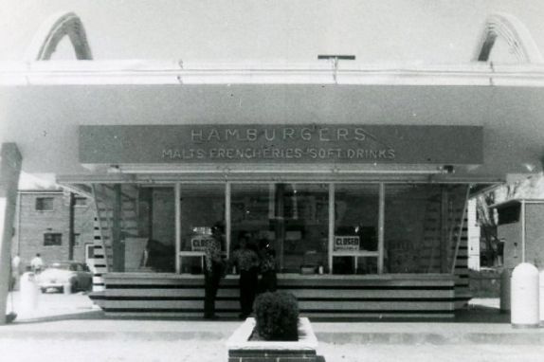
Ray Kroc’s first McDonald’s restaurant in Des Plaines, Illinois just prior to opening on April 15, 1955.
Notes:
Ray Kroc introduces himself to Maurice and Richard McDonald that day
He is Impressed by the efficiency of the operation
Narrow focus/minimalized menu focused on 9 items. Burgers, Fries, and Beverages
Others sold Burgers for $.30
McDonalds – Burger $.15, Cheese $.04, Star Attraction 3 Ounce Fries - $.10, Coffee $.05 soft drinks $.10 and Milkshakes $.20
NEXT SLIDE – PRESS BUTTON

Slide 4
Simplification: The McDonald brothers achieved success by simplifying their restaurant operation. They reduced the menu to just nine items, eliminating complexity and streamlining their processes.
Standardization: They implemented standardized methods for preparing and serving food, ensuring consistency across all locations. This standardization was crucial for efficient replication.
Automation: The McDonald brothers used automation to lower labor expenses and increase efficiency. Automated methods were employed in food preparation and service, reducing the need for extensive staff.
Notes:
What Ray observed that day.
McDonald brothers simplified their hamburger business
Removing complexity out of the traditional hamburger business
By implementing assembly line operations
Made fast food more accessible to broader audience
The Brothers were the original creators of the brand, pricing and the SYSTEM.
Ray Kroc's contribution was global expansion of the system.
Franchising
Replicated model on a massive scale with standardization of products and automization.
His vision made it possible to sell large volumes of high-quality burgers/fries at a lower price
NEXT SLIDE – PRESS BUTTON

Slide 5
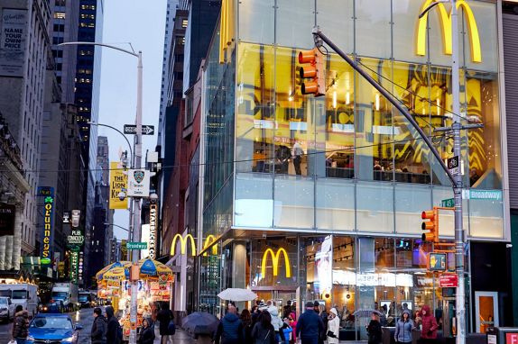
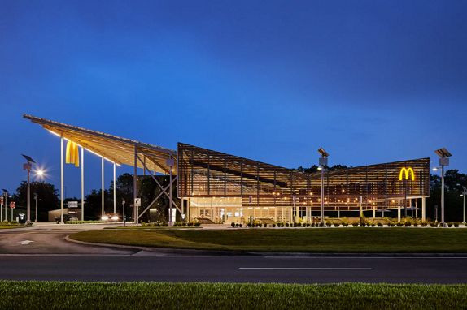
The Rest is History
2022
#1 in fast-food sales with $48+ billion
Over 13,000 stores nationwide
McDonald’s in Times Square
First net zero-designed restaurant at Disney
Notes:
And look at where McDonalds is today
#1 in fast-food sales with over $48 Billion in total sales
Over 13,000 stores nationwide
PROOF that through simplification and standardized processes, the complex can be simplified and replicated without Ray Krok being at each store
---- Moral of the story today
You don’t have to be an expert or the most educated Mannatecher in the room to be successful.
LOOK for WAYS to Simplify.
This brings me to the core of my breakout talk today.
NEXT SLIDE – PRESS BUTTON

Slide 6




THE POWER OF YOU PLUS TWO
Notes:
I want to share with you today A WAY TO simplify the onboarding of your new Associate
A way to break down the process of duplication/growth into a SIMPLE TO UNDERSTAND and Digest model of Duplication
AS WELL AS simplify the way you help a new Associate understand how to earn money with Mannatech.
I’d like to introduce you to the Power of You Plus Two.
NEXT SLIDE – PRESS BUTTON

Slide 7
YOU PLUS TWO
1. We encourage YOU and your family to enjoy Mannatech’s products. Gain a personal experience that you can share.
2. Focus on TWO sales to at least one NEW ASSOCIATE and one new CUSTOMER each month.
3. REPEAT Monthly – Along with Your New Associate(s)
Notes:
What does YOU PLUS TWO MEAN?
Experience the Products! – You are the YOU
Focus on Two Sales Each Month – This is the TWO – New Customer + New Associate
NEXT SLIDE – PRESS BUTTON

Slide 8
FORMULA FOR DUPLICATION
ENJOY
SHARE
BUILD
Experience Mannatech for yourself. Your personal product experience will often be the most valuable tool you have in sharing Mannatech with potential customers.
Invite at least 1 new Associate and 1 new customer each month to experience Mannatech’s products or opportunity.
Support your new Associate in engaging in YOU PLUS TWO.
Help them in inviting 1 new Customer and 1 new Associate each month.
†
†There is no requirement to personally purchase product under the Compensation Plan.
We advocate enjoying the products so you can share your experience with prospective customers.
Notes:
You can look at this system of duplication as three different steps.
ENJOY the Product Personally – Gain Your Own Experience
SHARE – 2 New People (Each Month) – Associate and Customer
BUILD – Support your newest Associate
Then REPEAT this each month. Set a Goal – 3 Month – 6 Month….
Setting realistic goals is what will keep your New Associate engaged..
NEXT SLIDE – PRESS BUTTON

Slide 9


McDonald
SIMPLIFY THE COMPENSATION PLAN
Retail $285.99
Member $259.99
PV 260
TIP: Building with a 250+ Point Volume (PV) Bundles unlocks the Mannatech Compensation Plan
All commissions and bonuses are earned through the sale of Mannatech products.
Notes:
Now that you have the Framework of YOU PLUS TWO...
I’d like to show you what this would look like modeled out if you were to duplicate with a 250 Point Volume (PV Bundle)
250 Point Volume Product Bundles work magic in the compensation plan.
It just so happens our TOP Bundle is OSP + Ambrotose
Here is a great bundle – 260 PV with GI ProBalance
NEXT SLIDE – PRESS BUTTON

Slide 10
INCOME DISCLOSURES:
  The following slides represent one example of how to build a business under the
  Mannatech Compensation Plan.
  This model illustrates one method that will generate a maximum amount of revenue.
  There are other ways to reach milestones. See Mannatech’s Career and Compensation Plan
  for more details.
  This is not a representation of what you may or will earn. Your individual, actual earnings
  under the Compensation Plan may be different depending on your individual efforts and skills,
  the customer base available to you and the time devoted to your business.
  All commissions, bonuses and incentive awards are earned through the sale of Mannatech products.
  As of August 2023, Mannatech’s Average Order Size in the U.S. was $191.00.
Notes:
But before I share any modeling with you, I’d like to be clear on a few things.
Let me run through this list with you.
NEXT SLIDE – PRESS BUTTON

Slide 11




MONTH ONE
YOU PLUS 2 is based on 250 PV
250 PV
Personally Enrolled Customer
Downline Enrolled Customer
Personally Enrolled Associate
Downline Enrolled Associate
YOU
250 PV
PPV – 500
DPV – 750
First Order Bonuses - $100.00
Commission Total = $100.00
Rank: Associate
250 PV
In 2022, individuals at the Associate rank earned average monthly commissions of $2.62
Notes:
Month One
Once again, this modeling is based around a 250 PV bundle. These numbers will vary based upon what is ordered.
Explain who makes up YOU (You/Your Family or Your Customers)
YOUR First Customer
Your First Associate
NEXT SLIDE – PRESS BUTTON

Slide 12
MONTH TWO
250 PV
250 PV
250 PV
YOU PLUS 2 is based on 250 PV
Personally Enrolled Customer
YOU
Downline Enrolled Customer
Personally Enrolled Associate
Downline Enrolled Associate
250 PV
250 PV
250 PV
A1
A1
PPV – 750
DPV - 1750
First Order Bonuses - $100.00
Power Seller Bonus - $75.00
Unilevel - $20.50
Commission Total - $195.50
Rank - Director
250 PV
A2
In 2022, individuals at the Director rank earned average monthly commissions of $175.71.
Notes:
Month Two
PERSONALLY – Repeat YOU PLUS TWO
However, you now help the Associate who joined you on first month engage in You + Two
I’m sure you’ve all been there, it’s HARD explaining the compensation plan!
But this model, with your new Associate, paints a picture of something that is achievable.
NEXT SLIDE – PRESS BUTTON

Slide 13
MONTH THREE
YOU PLUS 2 is based on 250 PV
Personally Enrolled Customer
YOU
Downline Enrolled Customer
Personally Enrolled Associate
Downline Enrolled Associate
PPV – 1000
DPV – 3500
First Order Bonuses - $100.00
Power Seller Bonus - $150.00
Business Development - $100.00
Mentor Bonus - $40.00
Unilevel - $67.00
Commission Total - $457.00
Rank - Silver Director
A1
A1
A1
A2
A2
A2
A2
In 2022, individuals at the Silver Director rank earned average monthly commissions of $266.52.
Notes:
Month Three
This is where something magical happens.
$457 is greater than the amount that the national average says will change their finances (monthly)
Team Two Business Development bonus is unlocked
Five Different Bonuses are Now “Unlocked”
NEXT SLIDE – PRESS BUTTON

Slide 14
MONTH FOUR
MONTH FOUR
YOU PLUS 2 is based on 250 PV
YOU
Personally Enrolled Customer
Downline Enrolled Customer
Personally Enrolled Associate
Downline Enrolled Associate
A1
A1
A1
A1
PPV – 1250
DPV – 7000
First Order Bonuses - $100.00
Power Seller Bonus - $200.00
Business Development - $100.00
Mentor Bonuses - $80.00
Unilevel - $250.00
Commission Total - $730.00
Rank - Executive Director
A2
A2
A2
A2
A3
A3
A2
A2
A2
A2
A2
A4
A3
In 2022, individuals at the Executive Director rank earned average monthly commissions of $691.84.
Notes:
MONTH FOUR
You can see how exponential growth takes place.
Once again, this is modeling perfect duplication, which isn’t likely to happen.
HOWEVER, if does provide a framework for you new Associates to see what can happen if they choose to build faster than YOU+2
NOW – This Modeling is great, but you might be wondering to yourself. I DON’T KNOW WHERE TO GET STARTED
NEXT SLIDE – PRESS BUTTON

Slide 15



Where to Start – Mannatech’s Core Four
  Top Performing Bundle
OSP + Complex - $230.99
231 PV
OSP + Complex - $240.99
241 PV
OSP + Complex - $259.99
260 PV
Notes:
Being that OSP + Ambrotose (CORE FOUR) is our TOP selling bundle…
I want to share with you process and tools that you can utilize to build with the Core Four Message of Nourish, Protect, Regulate, Communicate.
Three Great Bundles show in this Slide
NEXT SLIDE – PRESS BUTTON

Slide 16
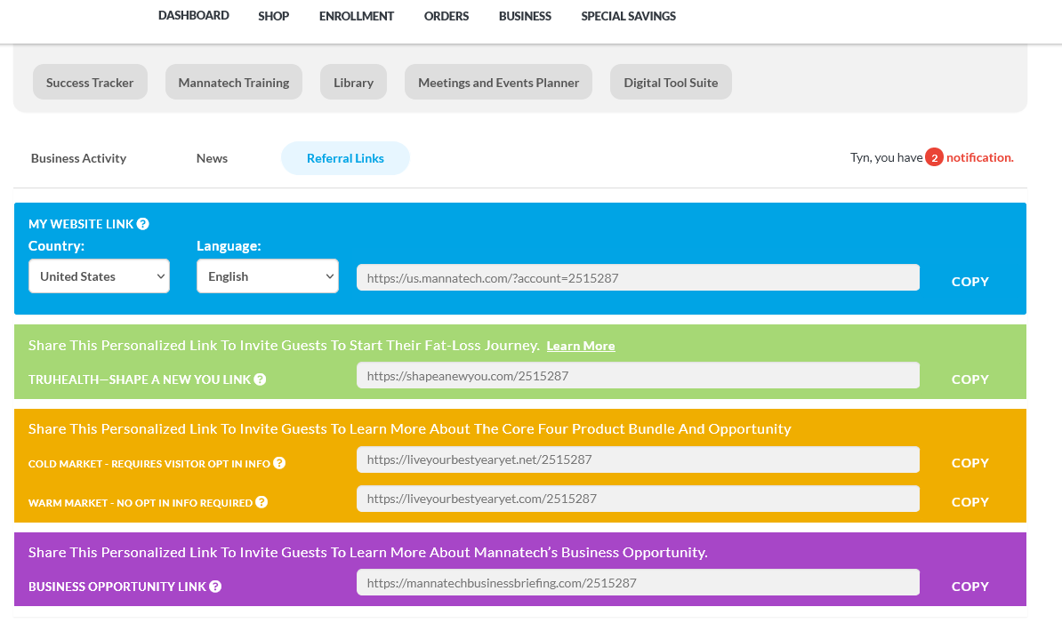
Where to Start – Lead Generation
  “Referral Links” – In Your Back Office – Cold and Warm Market Funnel
Notes:
If you’re looking to create new leads…. You have a LEAD Generation Tool in your back office built around the Core Four.
If you’re not familiar with “LiveYourBestYearYet” PMW pages….you have two different ones
In Back Office
NEXT SLIDE – PRESS BUTTON

Slide 17
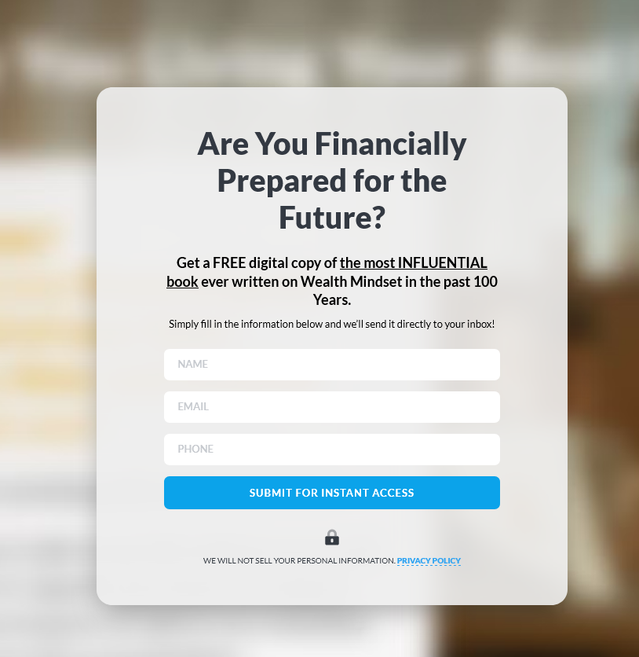


Prospecting/Lead Capture
  Cold Market Funnel
  Warm Market Funnel
Notes:
Cold Market Link – Captures Email for Follow Up
Think and Grow Rich – Napoleon Hill (emails them and emails you)
Warm Market Link – Introduces the Core Four + Business Opportunity
Doesn’t ask for any information. You can lead out by sharing this link by itself
NEXT SLIDE – PRESS BUTTON

Slide 18
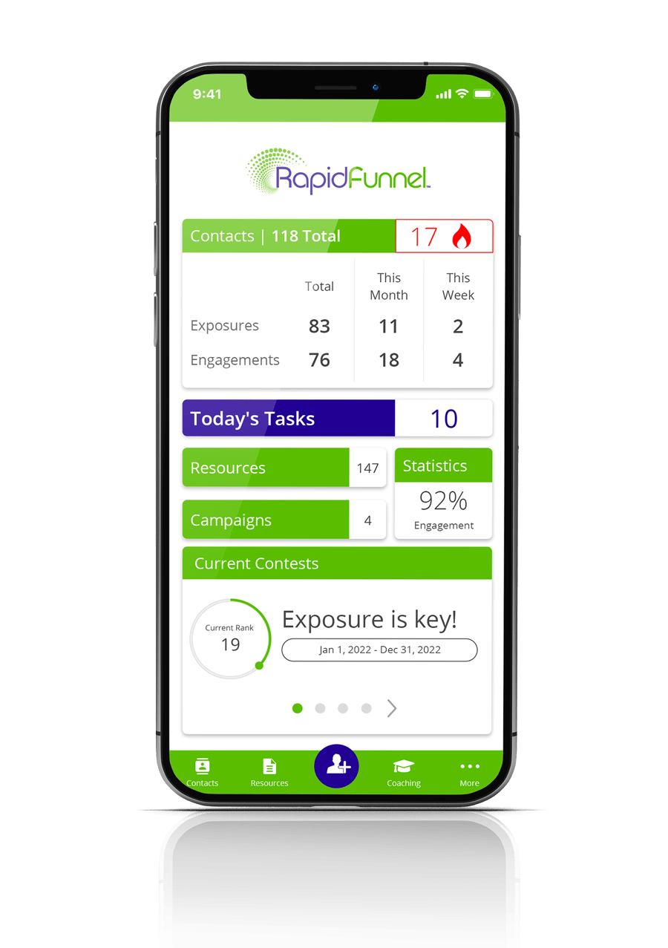
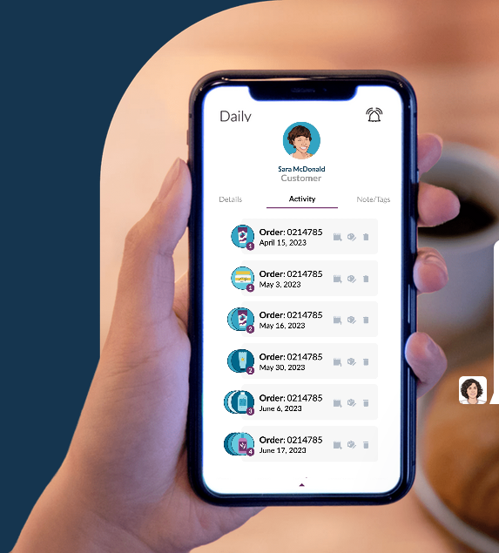
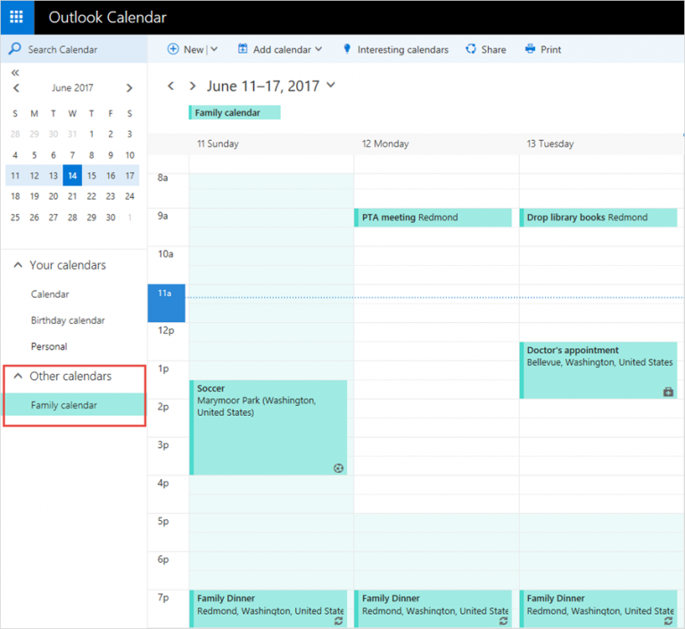
Your Personal Customer Relationship Manager
  Penny App Desktop/Mobile
  Rapid Funnel Desktop/Mobile
  Calendar/Contacts
Notes:
Now that you have a lead….
The fortune is in the follow up
Leverage a CRM – Penny Free, Rapid Funnel, or use your Calendar to book follow up.
Don’t let them go.
The power of Penny and Rapid funnel is, they have resources preloaded into the app to follow up with.
NEXT SLIDE – PRESS BUTTON

Slide 19
Resources for Pique Interest and Follow Up
  Mannatech.com (Your Back Office…Logged In)
    “Digital Tool Suite” – Located within Category “Business”
      Penny App (Desktop or Mobile)
        Core Fore Specific - Social Media Images, Scripts, Flyers, Links
      Rapid Funnel (Desktop or Mobile)
      Social Media Reels (Videos)
        Core Four Specific and More
      Core Four Personal Mannatech Website (PMW) Link
Notes:
Next – The follow up resources, based upon their questions or your inquiry on providing them more information.
All of this can be found by Logging into your back office – Click on Business, then Digital Tool Suite.
Both Mobile Apps – Core Four Specific Follow up and Reach out Resources - Scripts
Social Media Reels – Pique Interest
And you also have your PMW to a Core Four Specific Overview – All linked back to You
NEXT SLIDE – PRESS BUTTON

Slide 20
Resources for Pique Interest and Follow Up
    MannatechTraining.com – English/Spanish/Chinese
      Category “Products”
        FAQs, Information Sheets, and Videos for Core Four Specific Products
    Library.Mannatech.com – English/Spanish/Chinese
      Search “Core Four” to find multiple languages of
Notes:
You also have these websites, which are linked from the the Digital Tool Suite page in your back office.
Mannatech Training
Product Overviews, FAQs, Videos, Script Ideas as well – Each on the specific products in the core four
Also, training courses on how to share you PMW
Library - which is full of Core Four Resources - in English, Spanish, Chinese
Whether you build online or in person, starting with the Digital Tool Suite in your back office will help you navigate to the best tool for you
NEXT SLIDE – PRESS BUTTON

Slide 21
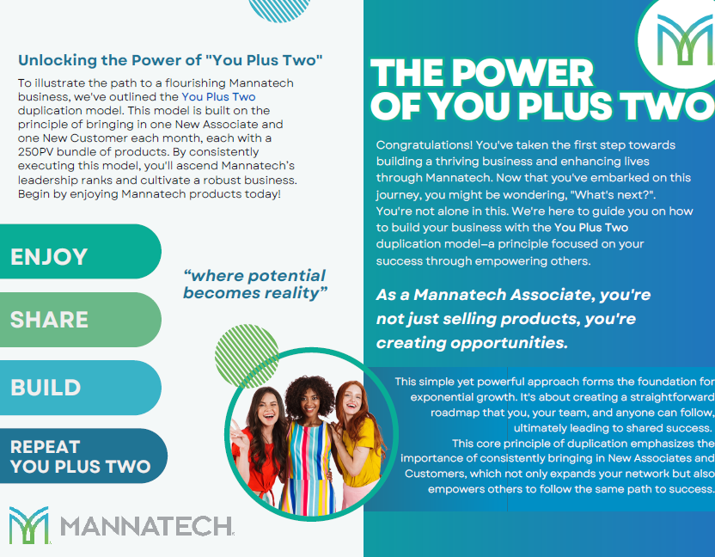
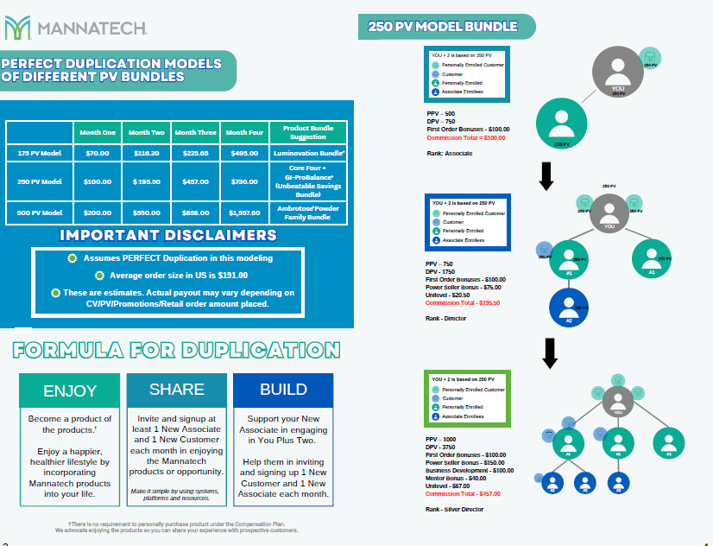
YOU PLUS TWO - Overview
Notes:
Before I close, I have prepared a print out for you that outlines the YOU PLUS TWO duplication model.
I have included an insert that share different PV bundle amounts, in case you’d like to see what duplication might mean for 175 PV or 500 PV bundles
I appreciate your time today. I look forward to the next couple of days. To Learn together and Celebrate your Success.
Thank you
NEXT SLIDE – PRESS BUTTON

Slide 22

THE POWER OF YOU PLUS TWO

